Slide 2

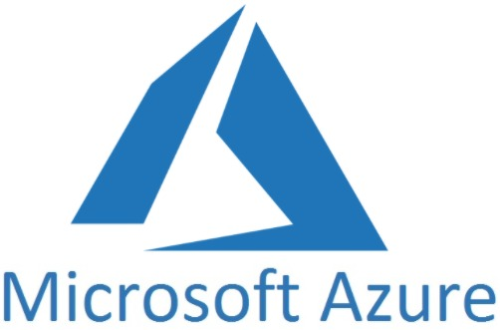

Cloud Models - Public
Applications
Virtual Machines
Host Machine
Notes:
For use by the general public

Slide 3


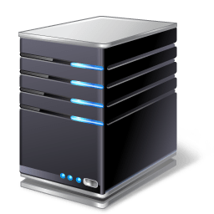
Cloud Models - Private
Cloud-based
Business 2
Applications
On-premise
Virtual Machines
Host Machine
Business 1
Notes:
For use by a single customer

Slide 4
Cloud Models - Community
Medical Practice
Insurance Provider

Slide 5

Computing Types - Hybrid
Cloud-based
On-premise
Virtual Machines
Transit Gateway
Host Machine
Host Machine
Business 1
Notes:
File System Permissions
NTFS Permission
Share Permissions

